Slide 1
Name-Aniruddha M. Khedkar Project on Advanced-MS Excel Title-Analysis of Customer Service Data for an E-commerce Company Nile.

Slide 2
1. Business Understanding-
Nile- E-commerce Company
2. Data Understanding-
Continuous Variables
Customer Sentiment
CSAT Score
Categorical Variables
Mode of communication used by customer (Channel)
Reason behind the complaint
Response time
Call Center
City, State, Month, Year

Slide 3
3. Data Preparation-
Extraction of month & date.
Assigning value to customer sentiment.
CSAT Score (Check for fill)
4. Chart Preparation & Dashboard Creation-
Bar Chart
Pie-Chart
Table
Map
Optimize Customer Service Processes Enhance Customer Experience

Slide 4
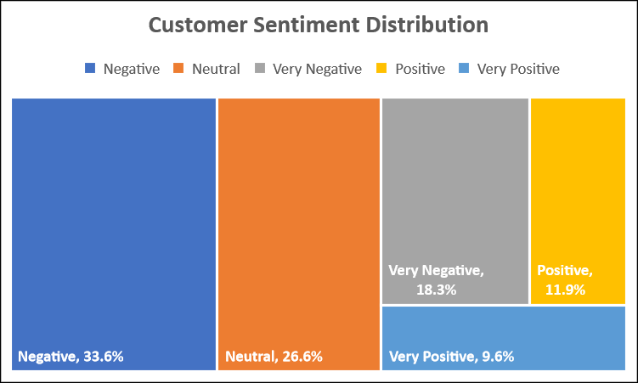
Objective 1- Customer Sentiment Analysis
Customer Sentiment Analysis
Mean | 2.61
Standard Error | 0.01
Median | 2.00
Mode | 2.00
Standard Deviation | 1.19
Sample Variance | 1.42
Kurtosis | -0.59
Skewness | 0.48
Range | 4.00
Minimum | 1.00
Maximum | 5.00
Sum | 85976.00
Count | 32941.00
Ranking used to convert text data to numeric data-
1 | Very Negative
2 | Negative
3 | Neutral
4 | Positive
5 | Very Positive
The mean value for customer sentiment variable is below 3. Hence, the customers are said to remained unsatisfactory for the given time period.

Slide 5
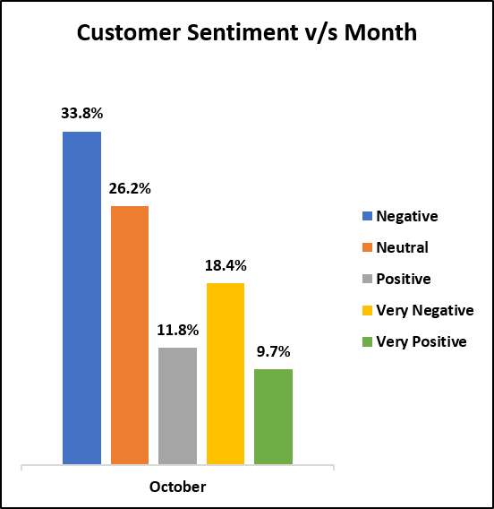
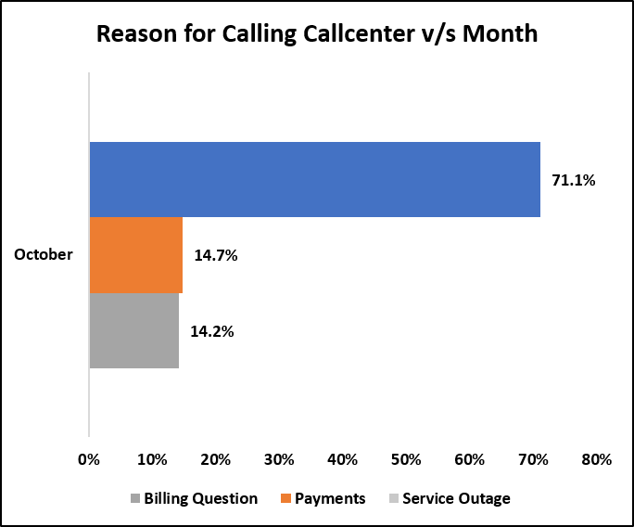
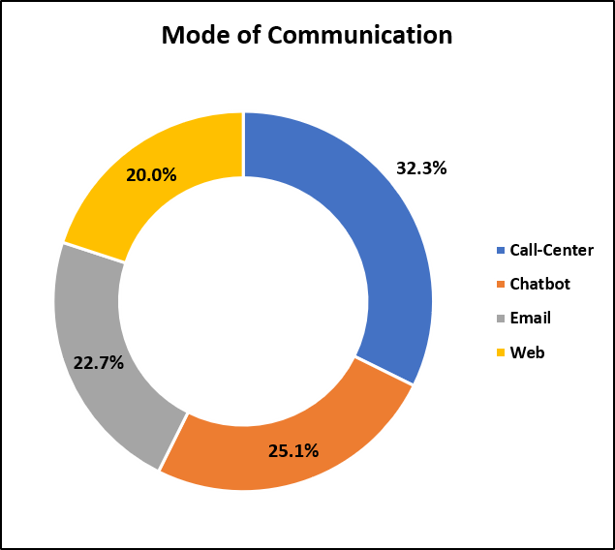
Objective 2- Root Cause Analysis
In 2020 October month registered maximum complaints (63.9%).
Most of the Customers complain regarding the billing issue.
(Chatbot, Email, Web)- 67.7%
(Call Center)- 32.7%
Customers preferred non-verbal communication

Slide 6
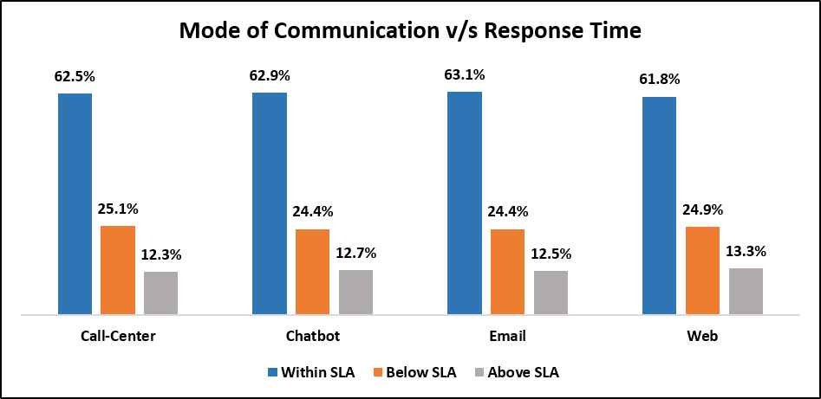

Objective 3 - Service Response Time Analysis
Irrespective of mode of communication and call center location, the response time percentage for below SLA remained (25%) and within SLA remained (62%).
Hence Company need to work on improving response time.
No service centre is lagging behind in terms of performance and customer service delivery.

Slide 7
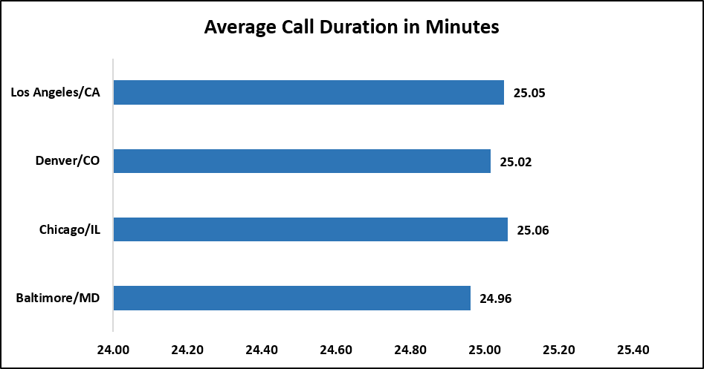
Despite having (62%) response well within stipulated time and (12%) above SLA, why customers are still showing negative sentiments?
Average call duration= 25 Mins (high)
As the average call duration time is very close to each other for all call centers and proportion of customer sentiment distribution is also close to each other. We can say that, the negative & very negative sentiment can be correlated with the average call duration.
Call_Center | Negative | Neutral | Positive | Very Negative | Very Positive | Grand Total
Baltimore/MD | 33.2% | 27.2% | 11.6% | 18.8% | 9.2% | 100.0%
Chicago/IL | 34.0% | 25.6% | 11.7% | 19.3% | 9.4% | 100.0%
Denver/CO | 33.3% | 26.8% | 12.0% | 17.9% | 10.0% | 100.0%
Los Angeles/CA | 33.8% | 26.4% | 12.3% | 17.6% | 9.9% | 100.0%
Grand Total | 33.6% | 26.6% | 11.9% | 18.3% | 9.6% | 100.0%
Hence, the time taken by service executive to understand the client’s problem despite previously mentioned through communication channels can be considered as an important factor contributing to negative sentiment creation.

Slide 8
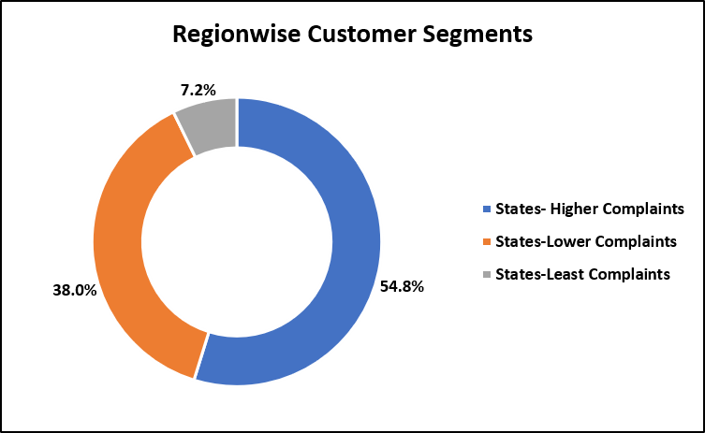
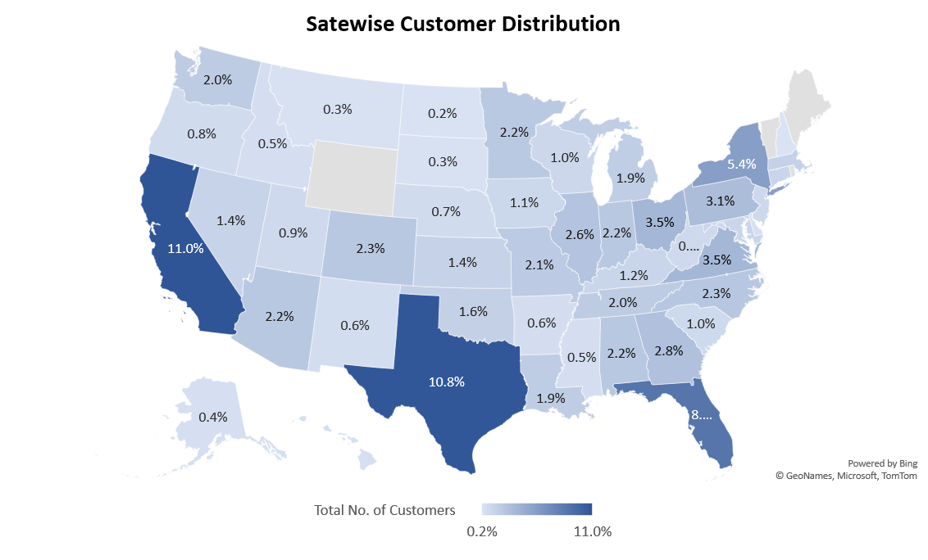
Objective 4 - Customer Segmentation
Customer Segmentation-
Region
Sentiment
Mode of channel
Total customers are segmented based on region. Three distinct regions are created where higher, lower, and least number of complaints being generated.
States with high customers
California | 11.0%
Texas | 10.8%
Florida | 8.6%
New York | 5.4%
Virginia | 3.5%
Cities with high customers
Sacramento | 1.04%
Los Angeles | 1.00%
San Diego | 0.78%
San Francisco | 0.77%
Fresno | 0.64%

Slide 9
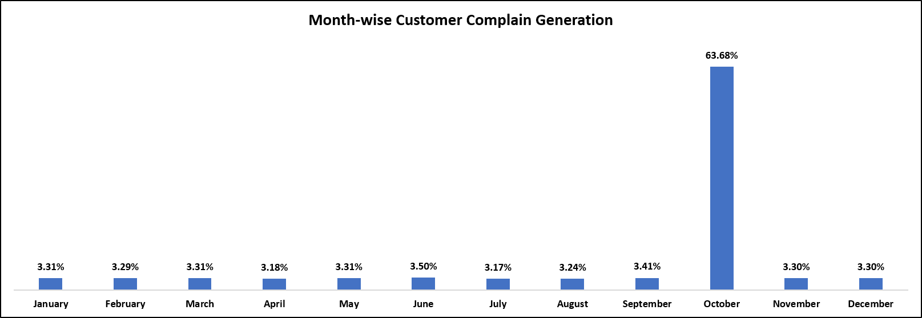
Objective 5 – Trends and Patterns Identification
In the October month, maximum complains are getting registered.
As we have understood that, the customers are complaining regarding the billing question, there must be some problem or efficiency was likely to be occurred in billing generation & maintenance system (SAP).

Slide 10
Recommendation to Nile’s -
1. Why service executives taking so much of time, while understanding/redressing client query?
Proper training program.
Technology intervention (To address the billing related problems faced by customer).
Dedicated team to solve billing issues.
2. Reduce the existing response time for within SLA and below SLA time. Map the SLA time for competitors and devise a strategy accordingly. (What competitors are doing?/How they are handling customer problems?).
3. As (67.7%) customers are preferring non-verbal communication, ask the service executives to be more proactive. (Create standard operating procedure to reduce service time and service failure).
4. Make non-verbal communication mode more interactive (Animations & Coupons).

Slide 11
